Slide 1

Updating Student Records
Temple College Continuous Orientation

Slide 2
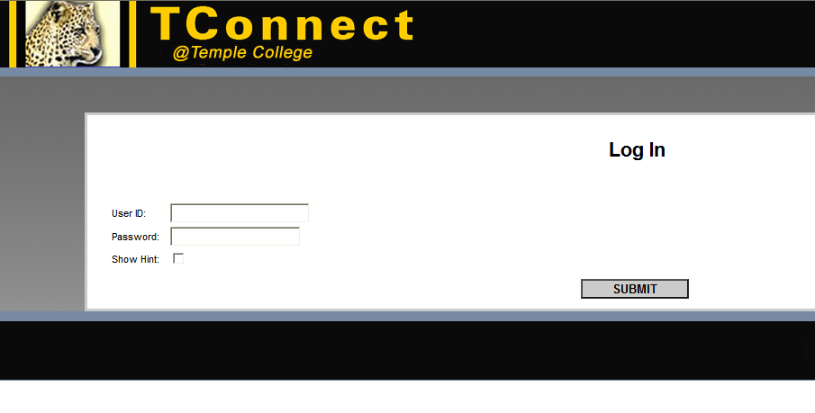
Updating Student Records
Update your address online via TConnect.

Slide 3
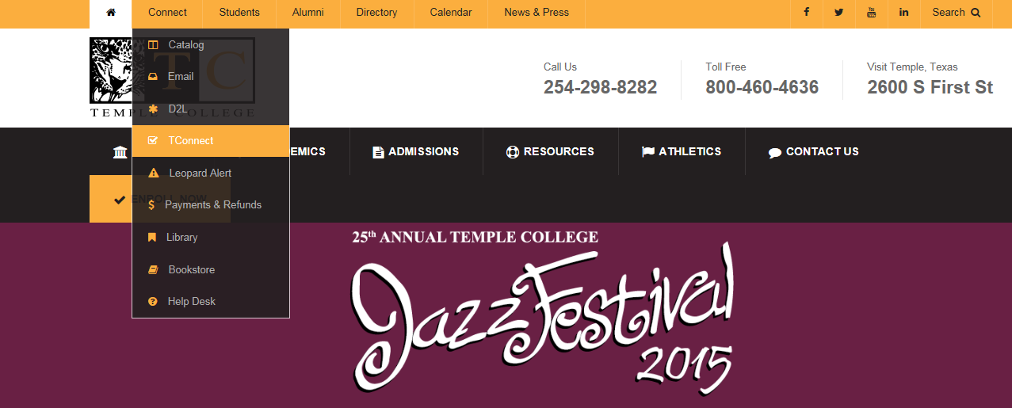
TConnect Registration
Go to www.templejc.edu and click on Connect, then TConnect.

Slide 4
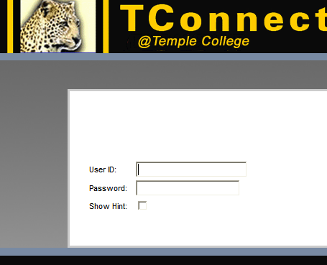
TConnect Registration
Your User ID is your last name
First initial of your first name and Last three digits of your student ID
Your 6 digit password is your birthday,(mmddyy) unless you have already accessed TConnect, then you have already set a password.
Example:
John Doe ID#0123456
Birthday January 1, 1975
User ID: doej456
Password: 010175

Slide 5
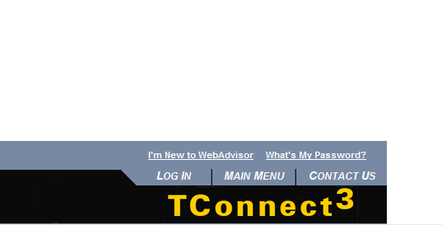
TConnect
If you cannot
remember your log in
or password scroll
down to the bottom
of the TConnect page and click on
“I’m New to WebAdvisor”
or
“What’s My Password? “

Slide 6
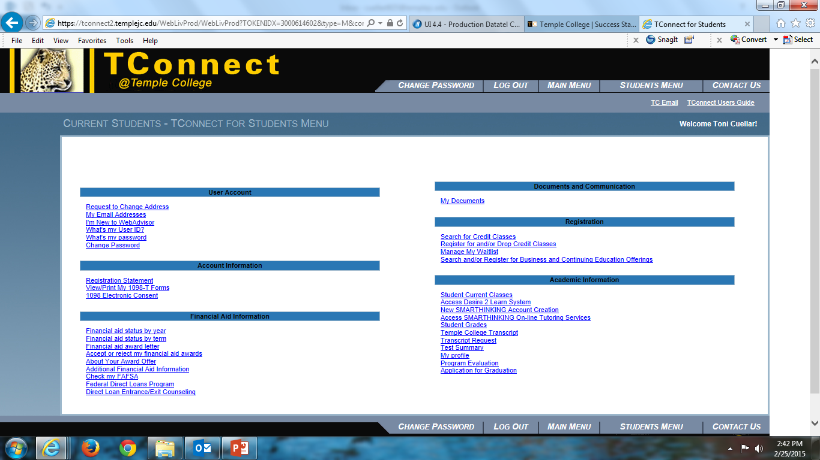
Submit Change of Address
Once logged in, select Search for Credit Classes
Notes:
Once logged in, select Search for Credit Classes

Slide 7
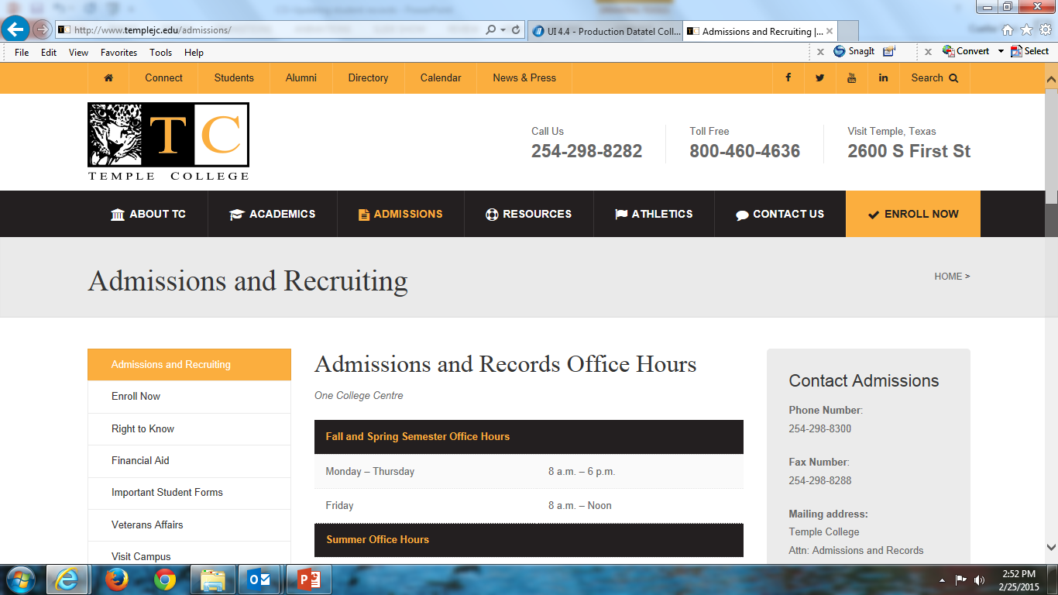
Visit WWW.TEMPLEJC.EDU
Click on Admissions

Slide 8
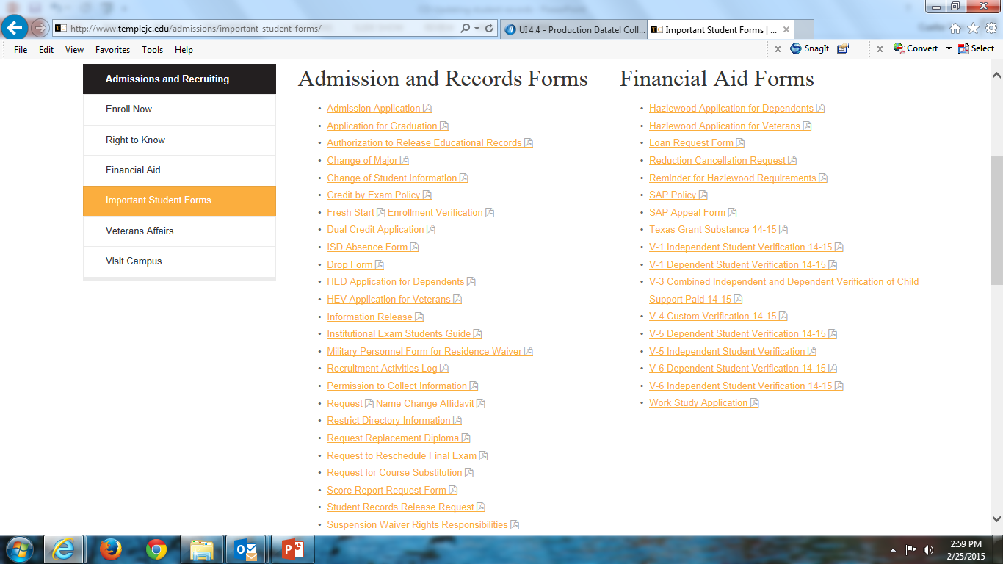
Click on: Important Student forms
Click on: Change of Student Information

Slide 9
Change of Student Information Form consist of:
Address Change – If changing from out-of-district/out-of-state to In-District, you MUST fill out the REQUEST FOR CHANGE OF RESIDENCY form. You must meet the residency requirements to qualify for In-District tuition. (Please see the Temple College catalog under residency requirements or see an Admissions and Records Specialist for details) and provide approved documentation as required by the college. Approved documentation includes: Rental/Home Lease, Utility Bills, or Tax Documentation.
Change of Contact Number
Correction of Social Security number or Date of Birth
  Change of Social Security Number requires a copy of your Social Security Card.
Name Change
  Must provide the approved documentation as required by the college. Approved documentation includes: Drivers License, TX ID card, Marriage License, Divorce Decree, Court Order, or a Social Security Card.

Slide 10
Admissions and Records Contact Information
Complete form and submit to Admissions and Records – located in the One College Centre (OCC)
Phone Number: 254-298-8300
Fax Number: 254-298-8288
Mailing address:
Temple College
Attn: Admissions and Records
2600 South First Street
Temple, Texas 76504-7435

Slide 11

Refresher
Office365
  Office 365 Help Desk WTC 511
eMail
  There are Tutorials for email and Office 365: Resources\eLearning\eLearning Tour
  http://ww3.templejc.edu/prodev/DEtour/index.html
TRiO
  Provides counseling, tutoring, and support
    Check the TRiO web site to see if you qualify
    http://www.templejc.edu/resources/tutoring/trio-program/

